Slide 1
Mobile Shop Management System
ABHIJITH AJI
ANAM JAMAL
ABHIRAJ P K
6th Semester
B.Sc Computer Science

Slide 2
Aim
The aim of the Mobile Shop Management System project is to develop a software solution that automates and streamlines the management of a mobile shop. It focuses on efficient inventory management, streamlined sales and billing.

Slide 3
Objective
The main objective of the project is to help the ongoing user help to attain an easy way to navigate the different brands of mobile details and solve the Customers problems.
It's basically build in the platform of.NET windows application which makes the application quite flexible and easy to be operated.
The manager of the Mobile store also finds it sufficient enough to view the details of the mobile and its sales.

Slide 4
Software and Hardware requirements.
Software Requirement
Operating system: - Windows7,above
Front-end Tool: - Visual studio 2010
Back-end Tool: - MySQL
Hardware Requirement
Windows XP and above.
Minimum 5 GB HDD space
3.00 Megahertz Intel Pentium IV Processor
1 GB RAM

Slide 5
Modules
Login/Module
Registration
View
Purchase and Bill

Slide 6
WorkFlow Diagram
User
Search
Customer
Admin
Print Mange
Login
Registration
Is valid login ?
No
Yes
Purchase & Bill
Stop

Slide 7
X
Login

Slide 8
X
User
Admin

Slide 9
User
Registration
X
Regid
First Name
Last Name
Mobile Number
Email address
Password
Repeat password
Confirm

Slide 10
Login
X
Username or Email
Password
Login
Forgot Password?
Sign up
Back to Home

Slide 11

X
Enter your search key
SEARCH
Home | Mobile item |  | My order | Logout

Slide 12



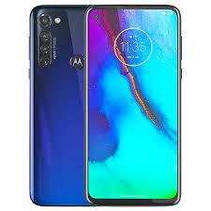


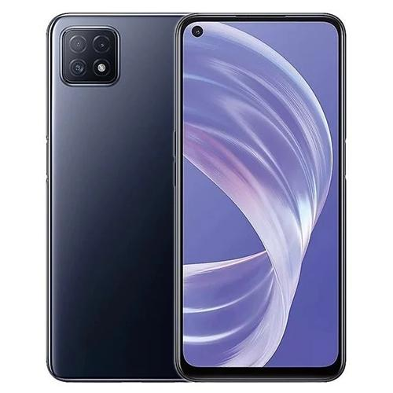

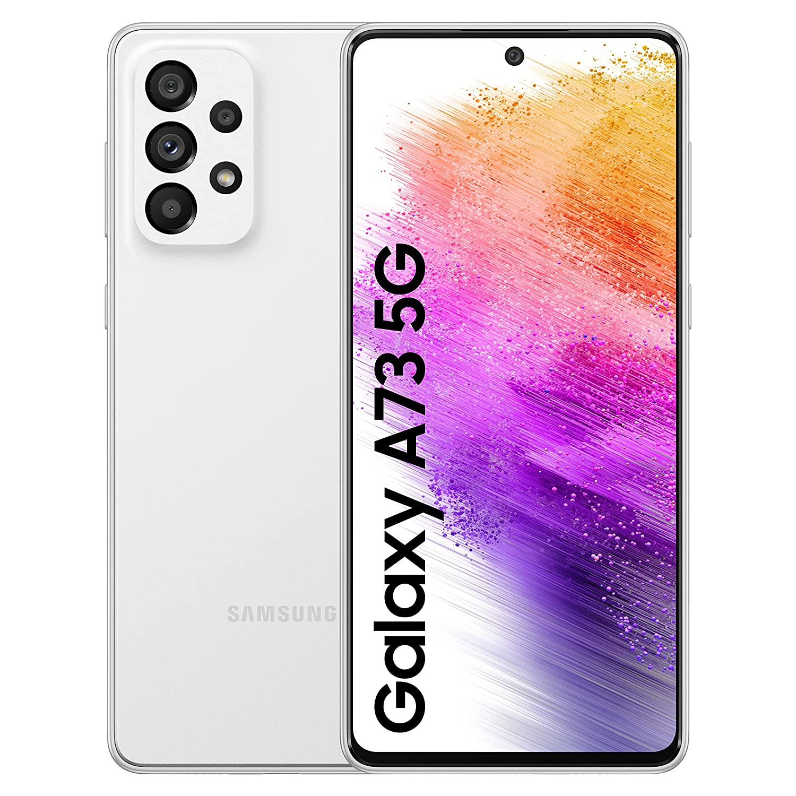

Mobile Show
X
Show All Product >
Asus Zenfone
Oppo A77
Moto G pro
Redmi Note 12 5G
Google pixel 7 pro
₹30,000
₹35,000
₹20,000
₹32,000
₹31,000
Nokia C21
Vivo A73
Apple Iphone 14 pro
LG K53
Samsung Galaxy A73 5G
₹25,000
₹32,000
₹79,000
₹14,000
₹59,000

Slide 13
Apple Iphone 14 pro
₹79,000
15.49 cm (6.1 inch) Super Retina XDR Display
48MP + 12MP + 12MP | 12MP Front Camera
RAM 6GB
ROM 128GB
3200mAh

Slide 14
ORDER SUMMARY
Apple Iphone 14 pro White 128GB
₹79,000
-
1
+
CONTINUE

Slide 15
Login or Sign Up
Enter Email/Mobile number
CONTINUE

Slide 16
Address
Full name
Regid
10-digit mobile number
Pincode
Enter Email/Mobile number
Address (Area and Street)
City/District/Town
Landmark (Optional)
Save and deliver here
Cancel

Slide 17
Regid
UPI
Choose on option
Credit / Debit / ATM Card
Net Banking
Cash on Delivery
CONTINUE

Slide 18
Apple Iphone 14 pro
₹79,000

Slide 19
J
Order Placed

Slide 20
Order Confirmed
Shipped
Delivered

Slide 21
Admin
1.New Mobile Item
2.View Mobile item
3.Edit/delete Mobile Item
4.Customer Order
5. Login

Slide 22
bjkgjk
ADMIN LOGIN
UserName:
Password:
LOGIN

Slide 23
New Mobile Item
Mobile ID :
Mobile Name :
Mobile Brand :
Features :
Camera :
RAM :
ROM :
Price :
Image :
CONTINUE
CLEAR

Slide 24
bjkgjk
View Mobile item
Mobile ID | Mobile Name | Mobile Brand | Features | Camera | RAM | ROM | Price | Image
CONTINUE
CLEAR

Slide 25
bjkgjk
Edit/delete Mobile Item
Mobile ID | Mobile Name | Mobile Brand | Features | Camera | RAM | ROM | Price | Image | Password
CONTINUE
CLEAR

Slide 26
bjkgjk
Customer Order
Regid | Customer Id | Customer name | Mobile Id | Mobile name | Mobile brand | Price | Address | Quantity | Image | Status : (confirmed, shipped and delivered)
CONTINUE
CLEAR

Slide 27
bjkgjk
Logout
YES
NO

Slide 28
THANK YOU

